Slide 1
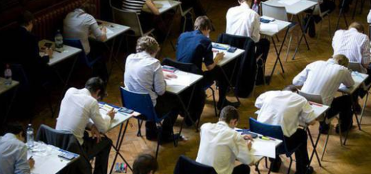
The Pursuit of Sovereignty: Ireland 1912-1949
Revision from Junior Cert…..
What was Home Rule?
Who were Nationalists & who were Unionists?
What was the name of the party in Ireland who were established to get Home Rule?
Who was their Leader?
Which party in Britain supported the IPP & which party was against it?
What was the Act of Union 1801?
What was the Power of Veto?

Slide 2
Ireland & Home Rule Question…1912-1916
Third Home Rule Bill 1912 – supported by Liberals/Opposed by Conservatives
It proposed a limited self government for the Irish – Westminster responsible for Taxation/Foreign Policy/ Issues of War
Opposed massively by Unionists for 3 reasons
Political – Wanted to remain united/loyal to British crown
Economic: HR would mean money and jobs shared more equally so less prosperity for Unionists
Religious Identity: Fear that HR would mean Rome Rule

Slide 3
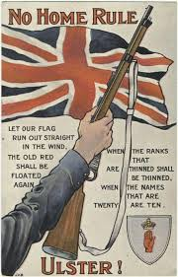
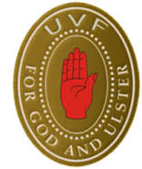
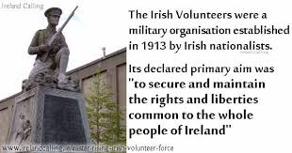
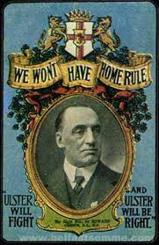

Slide 4
Unionist Campaign against HR
Edward Carson & James Craig led the Unionist campaign against HR
Carson leader of Unionist Party 1910 – qualified lawyer, his aim to keep all of Ireland under Westminster control
Craig - If HR came he wanted to keep Ulster Unionist
1912 the Solemn league & covenant was signed by 400,000 Unionist to resist HR “by any means necessary”
1913 UVF formed – the only active organisation willing to use violence to achieve political aims
https://www.youtube.com/watch?v=VBONYJIh8Nw

Slide 5
Nationalist Response…
November 1913 Professor Eoin Mac Neill established a nationalist organisation in response to UVF, Irish Volunteers were formed (IVF)
IRB started military training for IVF
They were also supported by associations such as GAA & Gaelic League
Popular Organisation and by early 1914 had 110,000 members
http://mcsweeneyhistory.weebly.com/20-th-c-ireland-ireland-the-struggle-for-independence

Slide 6
Essay Question
Title: To what extent did the 3rd Home Rule bill contribute to a divide in Irish society – 4 pages – 1 week (due 11/9)
Essay structure
1. Introduction
2. Paragraph one topic
3. Paragraph 2 topic
4. Paragraph 3 topic
5. Conclusion
Each paragraph must have 3 key points

Slide 7
The 1916 Rising
Planned by the IRB
Key Idea: Use of Violence to achieve political aims
Question……Where do we see this today????
Key Person: Padraig Pearse
Key Idea: The belief that spilling blood in pursuit of Irish Independence was an admirable and justifiable act
Agree or disagree….Why???
Where else do we see…”Blood sacrifice”

Slide 8
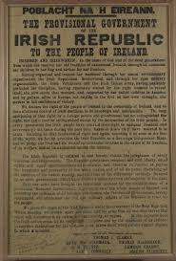
Causes of the Rising
Cultural Nationalism: i.e. GAA & Gaelic League
Revived IRB
Split in Irish Volunteers over WW1
Britain in WW1: “ England’s difficulty is Irelands opportunity”
Blood sacrifice belief i.e. Pearse
https://www.youtube.com/watch?time_continue=71&v=Cew_ZLgi3Cc

Slide 9
Planning the Rising
Easter Sunday set as date by IRB
Roger Casement arranges 20000 rifles to be delivered from Germany on board the Aud
Aud landed in Kerry and was captured by British
Eoin MacNeill and Irish Volunteers were needed - so IRB forge a document saying leaders of Volunteers would be arrested …Castle Document”
MacNeill cancels Rising plans but IRB still decide to go ahead on the Easter Monday…Big mistake!! – Dublin only

Slide 10
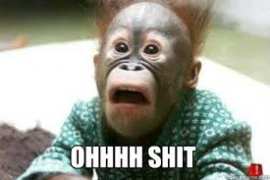
The Rising in action….
Padraig Pearse read the proclamation outside the GPO
https://www.youtube.com/watch?v=ERCVSDileo0
Key messages: ???
1500 Volunteers & ICA members took over GPO, Four Courts & Bolands biscuit mills
Fighting lasted 6 days
By end of Rising 12000 British troops in Ireland
Unconditional surrender to Britain on April 29th – Saturday…Failure????

Slide 11
Aftermath of the rising
3500 Irish Interned (prison without trial)
90 Rebels executed
15 leaders executed
The public had not been behind the rebels in large numbers…but the decision to execute led to an Anti-British sentiment all over Ireland
Executed leaders seen as Martyrs
https://www.youtube.com/watch?v=bDjREVKAvq4
Rise of Sinn Fein & Fall of IPP

Slide 12
Essay Question
To what extent were the seeds of Irish Partition sown in the period 1912-1916?

Slide 13
4 pages – 1 week (due 18/9)
Essay structure
1. Introduction
2. Paragraph one topic (2 parts)
3. Paragraph 2 topic (2 parts)
4. Paragraph 3 topic (2 part)
5. Conclusion

Slide 14
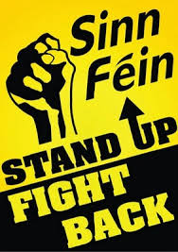
Rise of Sinn Fein

Slide 15
Sinn Fein
SF founded in 1905 by Arthur Griffith
Replaced as leader in 1917 by Eamonn De Valera (only surviving leader of rising)
Popularity rose 10 fold after being wrongly blamed for Rising
Demanded a Republic & Abstained from attending parliament in UK
British wanted to force Irish people to join British army (Conscription)
1918 general election results
SF 76 seats
IPP 6 seats
Unionists 26 seats

Slide 16
Sinn Fein’s rie..Why??
IPP & Redmond declined in popularity after accepting an agreement with Lloyd George after the rising
Prisoners in prions such as Frongoch in Wales became even more Republican
Griffith and Abstentionist policy
Count Plunkett, father of murdered Joe won a seat and refused to sit in Westminster & Jailed Joe McGuiness won a seat in Longford
1917 Devalera elected as President of Sinn Fein, and then also Irish Volunteers – unity between the two
Failure of the “Irish convention”
Conscription crisis
The “German Plot”

Slide 17
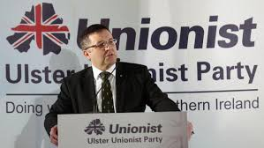
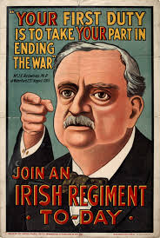
Irish Convention: Failure
British PM Lloyd George establishes Irish Convention to facilitate Home Rule
Attended by IPP, UlsterUnionists
Boycotted by SF & Labour
Unionists would not negotiate anything until “Consultation with Ulster people”
What effect might this have????
Redmond dies in March 1918, Negotiations end in failure April 1918

Slide 18
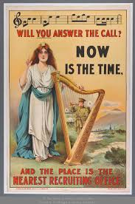
Conscription Crisis
April 1918 – Conscription introduced by British into Ireland
Opposed by SF, IPP & Labour, SF had support of Catholic Church
2 million people sign anti-conscription pledge and rallies nationwide protesting against it
SF & IRISH Volunteers both see increase in support and members
Britain abandons Conscription plans, victory for SF

Slide 19
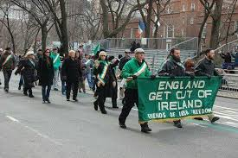
GERMAN PLOT
British Government arrange for arrest of over 70 SF leaders
Allegedly over plan to import Arms from Germany….However no proof!!!
Increased SF popularity even more!!
What else did????
SF, Gaelic League & Irish volunteers also banned by British!!

Slide 20
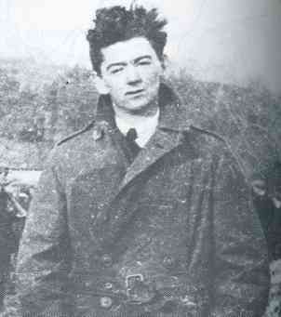
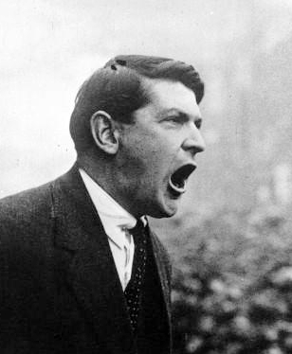
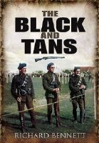
War of Independence 1919-21
4 Sections – Topics/Paragraphs
1. The First Dail
2. The War 1919-21
3. Major Incidents
4. Peace

Slide 21
First Dail
Sinn Fein were ABSTENTIONIST…would not sit where?
First Dail met January 19 1919 – only 27 MP’s as rest were imprisoned over the German Plot
SF set about setting up their own government in Ireland
Democratic Programme established – Programme of Education & Social Welfare
SF courts set up – encouraged people to use these instead of British courts
Arthur Griffith = Minister for Home Affairs
Michael Collins = Minister for Finance
W.T. Cosgrave = Minister for local Government
SF Problems: 1. Lack of experience 2. problems establishing control over IRA

Slide 22
The War 1919-21
The first fighting was at Soloheadbeg, Tipperary, on 19/1/1919 when an RIC patrol was ambushed by an IRA
The IRA used guerrilla tactics against the British forces. These were ambush or “hit and run” tactics.
Collins: Director of Intelligence & set up The Squad to kill spies & detectives - 10,000 reward for him
Organised Flying Columns: small groups of mobile armed men who ambushed others
Tom Barry - organised Crossbarry & Kilmichael ambushes

Slide 23
The War 1919-21
Lloyd George ( British PM ) organised Black & Tans: WW1 Soldiers sent in to help army – mercenaries & Auxillaries: Ex officers to fight IRA https://www.youtube.com/watch?v=SJv8QVRT09s
Passed the Government of Ireland Act 1920 (6 county Unionists) which set up Parliament in Dublin and Belfast but SF rejected Dublin Parliament
Big Incidents: Cork Lord Mayor Tomas MacCurtain murdered by RIC in 1920,, Black & Tans burned Cork City to the ground and targeted civilians (ACTS OF TERROR), BLOODY SUNDAY

Slide 24
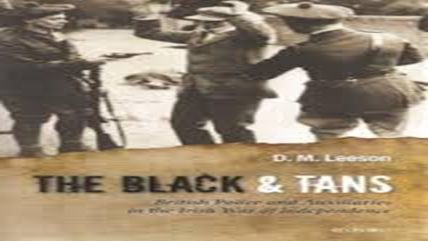
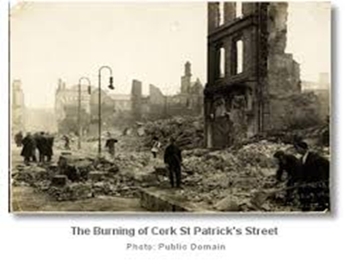
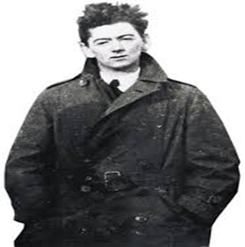
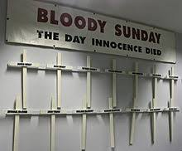

Slide 25
Peace
1. By 1921 both sides wanted peace for the following reasons:
1. The IRA was running short of men and ammunition
2. the people wanted peace
3. the British government was being criticised at home and in the USA for the behaviour of the Black and Tans and Auxiliaries
4. the war was costing the British government a lot of money.
Both sides agreed to a truce in July 1921.

Slide 26
Anglo Irish Treaty

Slide 27
Preliminary Negotiations
DeValera & Lloyd George met 4 times
Wishes:
Dev
1. Wanted 32 county republic
George
1.Ireland to remain with Britain but get Dominion status
2. Britain to maintain control of Northern Ireland
3. Wanted naval bases for British army in Ireland

Slide 28
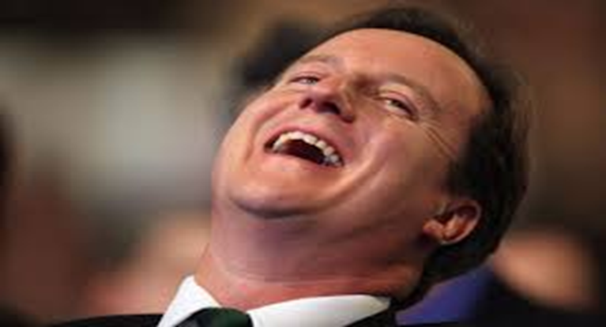
Offer & counter offer
August – September 1921
1. Key issue!!! : how to reconcile de Valera’s concept of full independence with Lloyd George’s insistence that Ireland should remain within the empire.
2. De Valera, at this stage came up with the ingenious and constitutionally brilliant – if difficult – concept of ‘external association’.
3. Under this suggestion Ireland could enjoy the freedom of an independent state but, whilst not being part of the empire, would be ‘externally associated’ with Britain by a sort of special alliance.
Answer….
Britain would not accept this and talks stalled.

Slide 29
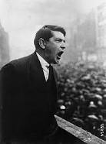
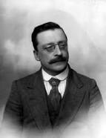
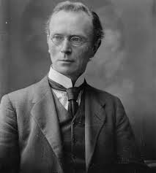
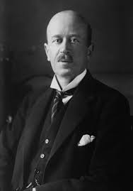
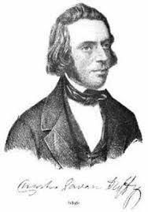
Delegations…
Ireland

Slide 30
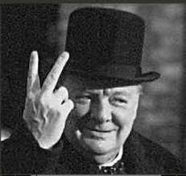
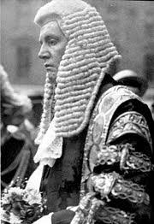
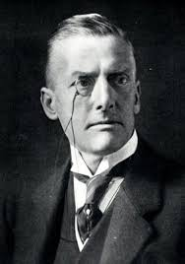
Britain

Slide 31
Main Issues
How could Ireland be satisfied and achieve their aims (aspirations)….while remaining a part of the British Empire?
What was the position of Ulster to be within this new Union?
What would the position be on the area of Defence & War
More minor issues = 1. Trade & 2. Financial matters
Oath Of Allegiance!!!
Complex situation - Partition/Oath/ Dominion Status / Boundary Commission/ Independent Republic

Slide 32
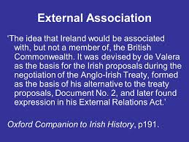
What was Ireland’s strategy
They did not have a clear strategy…there Ace up the sleeve was the idea of “EXTERNAL ASSOCIATION” but once did was rejected they had no clear strategy
https://www.youtube.com/watch?v=5L3cpH1TyTg
https://www.youtube.com/watch?v=dpD4ywwBUS0
What Ireland's negotiating might have looked like?
https://www.youtube.com/watch?v=At7Ma7FLFo0

Slide 33
Revisit questions
What did Ireland want from Anglo/Irish Treaty -Jack
One thing Britain wanted – Dylan
Another thing - Jake
Two members of Irish delegation – Conor
Two of Britain's team - Megan
One main issue – Carla
Another main issue – Liadh
What was external Association - Sean

Slide 34
The Negotiations….
Lasted two months….
Full delegation teams meant no early progress so sub committees were set up
Biggest issue for Britain –Oath of Allegiance & Dominion status
Ireland – Accept Free state instead of Republic & commonwealth instead of Crown
Naval bases issue passed no problem - & agreed the portion of UK national debt to repay
External Association was never going to be accepted by Britain as it required Ireland leaving British Empire

Slide 35
The Negotiations….
The wording of the Oath was amended to be more “Nationalist friendly” but still unacceptable to hard-core Republicans
A boundary commission was set up to sort the issue of the border as set out by Government of Ireland Act 1920
Irish delegation expected 3-4 counties to be given to the South
6/12/1921 George stated that a “immediate & terrible” war would commence on Ireland if they did not sign the Treaty within 3 days
Ireland signed the Treaty…Collins stating “I tell you this, early this morning I signed my own Death Warrant”
Collins also saw it as a first step to full Independence

Slide 36
Terms of the Treaty
Treaty signed 6/12/1921
Dominion Status for Southern Ireland
Ireland now Known as Irish Free State
King’s representative in Ireland would be Governor General
Treaty Ports (Cobh, Beerhaven & Lough Swilly) kept by Britain
Boundary Commission created to deal with Ulster Question
Oath of allegiance was introduced in Ireland

Slide 37
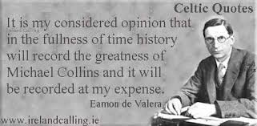
Treaty Debate in Ireland: 14 December 1921 – January 7 1922
https://www.youtube.com/watch?v=-Z_z6lSgB_8
Arguments For accepting:
Military – weak IRA & Threat of “Terrible War”
Stepping stone to full Independence: “The Freedom to achieve Freedom”
Dominion Status better than Home Rule – 1. Irish Flag 2. No more British troops in Ireland
The Treaty was the best deal that could be achieved!! - Collins, Barton & Griffith

Slide 38
Arguments for Rejecting
Oath of Allegiance : Unacceptable to hard-core Republicans & favoured External Association
Treaty seen as a betrayal of fallen comrades of 1916 & War of Independence
Ireland could not have a Foreign Policy as long as Britain had Treaty ports
Objected to role of Governor General & King as head of Irish state
Anti-Treatyites: De Valera, Cathal Brugha & Austin Stack

Slide 39
The Vote and outcome
All deputies had spoken by time Treaty was voted on
All 6 Female TD’S including Countess Markeivich voted against the Treaty
PARTITION did not feature in debate over Boundary Commission
Over Christmas do you think people wanted peace or not???
DAIL Vote 64 votes to accept & 57 votes to reject
https://www.youtube.com/watch?v=Owle-LyXWYg
Irish Society divided – Devalera led walkout from Dail & resigned from

Slide 40
ESSAY TITLE
Why were the Treaty Negotiations so Controversial
OR
To what extent was the Anglo Irish Treaty Responsible for the Irish Civil War

Slide 41
To what extent was the Anglo Irish Treaty Responsible for the Irish Civil War
1. Main Issue – Treaty
2. Other key issues – Split in IRA & Actions of Anti Treaty IRA/
3. Failure of Pact & immediate actions prior to War

Slide 42
Causes of Irish Civil War
The Treaty
IRA Split nationwide
Weakness/Inexperience of provisional government
Anti-Treaty actions
Failure of Collins/Devalera Pact
https://www.youtube.com/watch?v=k9ayLHPLROg

Slide 43
Causes of Irish Civil War
Treaty Issues– 1. The Oath 2. Republic was declared in 1916 Proclamation & 3. The fallen comrades of Rising & War of Indep3endence
Fragile IRA – There was a lack of overall control and so Flying columns all over the country had different loyalties
As Britain left barracks Pro& Anti-Treatyites set up there & Rory O Connor took over the Four Courts
Collins reneged on ELECTION PACT agreement with Devalera
Pro Treaty won elelction easy (58TD’s to 35)
Anti Treaty – captured General of Free State Army – O’Connell
https://www.youtube.com/watch?v=udbcxALgtbI

Slide 44
IRISH CIVIL WAR 1922-23

Slide 45
Explain the term Flying Column – Liadh
During the Civil war, 1922-23, what was the Munster Republic? – Connor
List two terms of the Anglo-Irish Treaty 1921? – Ellie
List two causes of the Irish Civil war? – Jake
How was the Irish Free State Government weak ? - Jack
What was the Election Pact between DeValera & Collins? - Dylan
What actions by the Anti-Treatyites contributed to the Civil War breaking out – list two (Lucie & Carla)
What was the immediate trigger which started the war? - Sean

Slide 46
The War in Action
From the firing of the first cannon the fighting lasted one week in Dublin as weapons from Britain helped Free State Army defeat irregulars & capture O Connor & the Four Courts
Anti-Treaty retreated to the Munster Republic
Pro-Treaty Recruitment drive – 60000
They attacked and defeated irregulars in Limerick & Waterford
Irregulars went back to using Guerrilla Warfare tactics

Slide 47
The War in Action
Regulars (pro-treaty) attacked Irregulars (anti-treaty) in Cork and took it
Griffith died from Brain Haemorrhage in August 12th 1922 & Collins ambushed at Beal Na mBlath 22 August 1922 – 10 days two key figures gone
William T. Cosgrave took over as leader of Irish Free State and brought in Emergency Powers Act – 12000 imprisoned without trial (interned)
IRA chief of staff Liam Lynch killed and replaced by Frank Aiken
De Velara & Frank Aiken finally got IRA to lay down arms and agree to ceasefire 1923 – End of civil War

Slide 48
Impact/Results of Irish Civil War
About 900 people – military and civilians killed
Some of Ireland best and brightest leaders died i.e. Collins, Lynch & Griffith
Dublin was destroyed - as were many roads over 38 million euro of damage caused to buildings/Infrastructure
Civil War left behind a bitter & divided Irish society
Ireland two biggest political parties were born
Cumann Na nGaedahl – Pro-treaty side (later Fine Gael) & Fianna Fail – Anti-Treaty side

Slide 49
Homework Questions
What event marked the beginning of the Irish Civil War
How did the Republicans fare in Dublin during the civil War
What was the Munster Republic
Name the two pro-Treaty leaders who died in August 1922
How did the Civil War end
State two consequences of the Irish Civil War on Irish society

Slide 50
Essay
To what extent was the Civil War ended by the actions of the Irish Free State Government

Slide 51
The Irish Free State 1923-32 - Overview
Cumann na nGaedhael - Following the end of the Civil War the pro-Treaty members of Sinn Féin formed Cumann na nGaedhael.
This new party would lead the first government of the Irish Free State.
WT Cosgrave, who fought in the GPO in 1916, became leader of Cumann na nGaedhael and the first President of the Irish Free State.
From 1923 to 1932 the Cumann na nGaedhael government was responsible for a number of achievements:
Setting up of An Garda Síochana
Establishing an independent judiciary (non bias)
Setting up the Agricultural Credit Corporation (ACC)
1927 Electoral Amendment Act
The Shannon Scheme
Brought Ireland into League of Nations
Statute of Westminster

Slide 52
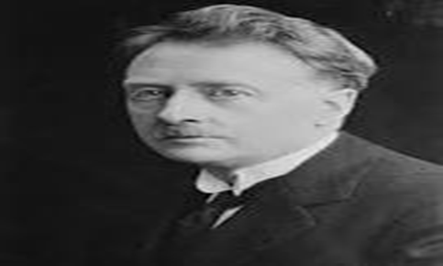
Irish Free State 1923-32 – C na G in power
Key areas –
1. Domestic & Foreign policy (Achievments)
2. Threats to the new Free State Government
3. Economic Policies

Slide 54
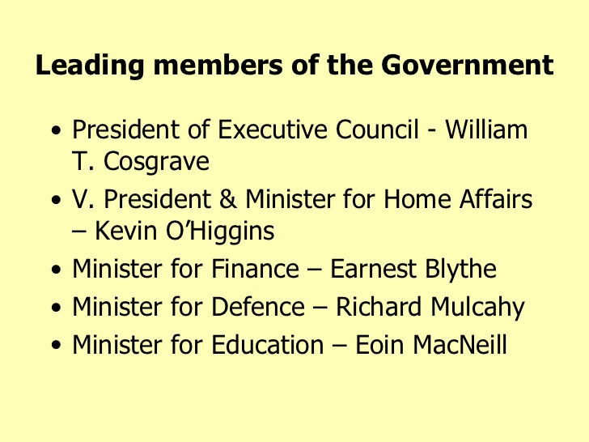

Slide 55
Domestic achievements/State Building
Local government had much more power than in the British system
New Civil Service established – similar to Britain – 98%
Establishing of Civic Guard/Gardai Siochanna
Unbiased court system - similar to British system
https://www.youtube.com/watch?v=Hjzt_HTh4AI
https://www.youtube.com/watch?v=DaQjsfOMTTI

Slide 56
Foreign Policy – & Relations with Britain
Biggest problem was to manage relations with Britain while slowly increasing own Independence
Constitution of 1922 – Established the Irish Free State giving Dominion Status (Partial/Limited Independence) Independence) 1. Governed General & 2. Oath to King
Joined League of Nations – shows level of Independence
Anglo-Irish Treaty established as International Agreement
Passports Issued
Statute of Westminster!! – Biggest Achievement as cemented more Independence and decision making abilities for Ireland
https://www.youtube.com/watch?v=Wabsi_mvgQg

Slide 57
Threats to the Irish Free State
Boundary Commission: No significant changes in Boundary & forced Eoin MacNeill to resign
Civil Unrest: Post office strikes & cut to salaries of teachers and Gardai & OAP
Red Scare – Left Wing IRA group 1929-32 (Saor Eire)– Communist Ideology
Army Mutiny – 1924
Assassination of Kevin O Higgins
https://www.youtube.com/watch?v=T8eztdbQpCg

Slide 58
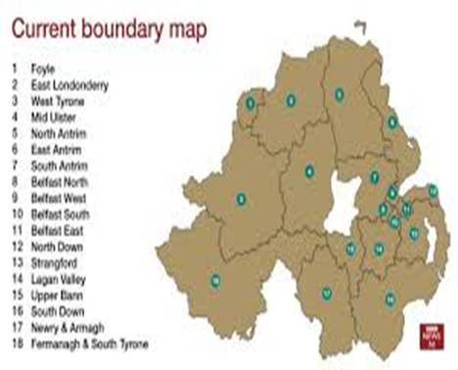
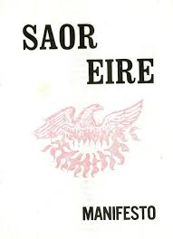
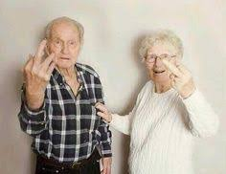
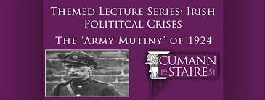

Slide 59
PEQ
How did the Irish government contribute to the consolidation of democracy, 1922-1932?
Who handled Anglo-Irish relations better, W. T. Cosgrave or Éamon de Valera? Argue your case, referring to both.
To what extent were C na G a success in power from 1923-32 or…..Were C na G a success or a failure between 1923 & 1932 – explain your answer (Luicie & Carla)

Slide 60
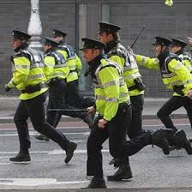
Reasons for Decline of C na G (Take Down)
They were seen as Conservative and middle class…not for “Ordinary People”
They cut old age pensions, teachers & Gardai wages
Failure OF THE Boundary commission
Lack of leadership/Organisation – i.e. Assassination of the charismatic O’Higgins…Cosgrave not Charismatic
FF rose in power under charismatic De VALERA REPRESENTING THE “Ordinary people”
https://www.youtube.com/watch?v=QtmMPO95IOA

Slide 61
Fianna Fail in power 1932-39 – Eucharistic Congress
Catholic church had been persecuted under Penal Laws
• Protestant Church of Ireland had been Established
(Official) Church until 1869
• Majority of Catholics supported nationalist political parties
• Some protestants feared discrimination under Home
Rule (‘Home Rule is Rome Rule’)
• Most unionists were protestant
• Most nationalists were Catholics (but there were also
some very famous protestant nationalists) – Wolfe Tone/Parnell
• Majority of population of 26 counties of Irish Free State
were Catholics
• Some saw Catholicism as a part of Irish identity

Slide 62
What was the ‘Eucharistic Congress’?
• Every 3 or 4 years a‘Eucharistic Congress’ was held in a different country
• Catholics organised a series of religious events to
celebrate the presence of Christ in the Eucharist (Communion)
• Masses, processions, conferences and receptions
would be organised
• Priests, Bishops and Cardinals and would be invited to attend

Slide 63
Why Ireland for 1932 congress?
1929 was the centenary of Catholic Emancipation
Vatican sent the 1st Papal Nuncio (ambassador) to Ireland
C Na G government open discussions with Vatican about holding Congress in Ireland
Pope Pius XI (1922-1939) decides to have the 31st Eucharistic Congress in Ireland (1,500 years after arrival of St. Patrick in 432 AD)
https://www.youtube.com/watch?v=dKR7olqpL80

Slide 64
Timeline & podcast
Preparation: Retreats, Cardinal Lauri’s arrival, Blackrock College garden party, State banquet
Events of the Congress, 22-26 June
High point: Phoenix Park mass, 26 June
https://soundcloud.com/historymatters365/what-was-the-significance-of

Slide 65
Eucharistic Congress Garden Party, June 1932.

Slide 66
Mass on O'Connell Bridge during the Eucharistic Congress, June 1932

Slide 67
Pope Pius XI addresses the faithful, 26 June 1932.

Slide 68
His eminence, Cardinal Lorenzo Lauri, Papal Legate
https://www.youtube.com/watch?v=EaUlGKPHN4w

Slide 69
Essay: Why was it significant/important to Irish life
Important to Free state government i.e. what it demonstrated
Importance of Catholicism in Irish society & power of church
New relationship between church & state
Cultural identity for Ireland i.e. Irish language/poetry/plays
However….Led to new divisions….

Slide 70
Fianna Fail in power in 1932-39
Results of 1932 election gave FF a majority with 72 seats v C na G 57
FF became party in power and would stay in power until 1948
4 Big things
Dismantling the Anglo-Irish Treaty - FP
Economic War- Economy
The Blue shirts & IRA threats – Domestic policy
Emergency

Slide 71
Domestic political developments/achievements
Dismantling the Anglo-Irish Treaty
Abolishing the Senate
The New Constitution 1937 – Bunreacht na hEireann
Threat of Blueshirts & eventually IRA
The Emergency
http://mcsweeneyhistory.weebly.com/20th-c-ireland-ff-in-power-1932-1948

Slide 72
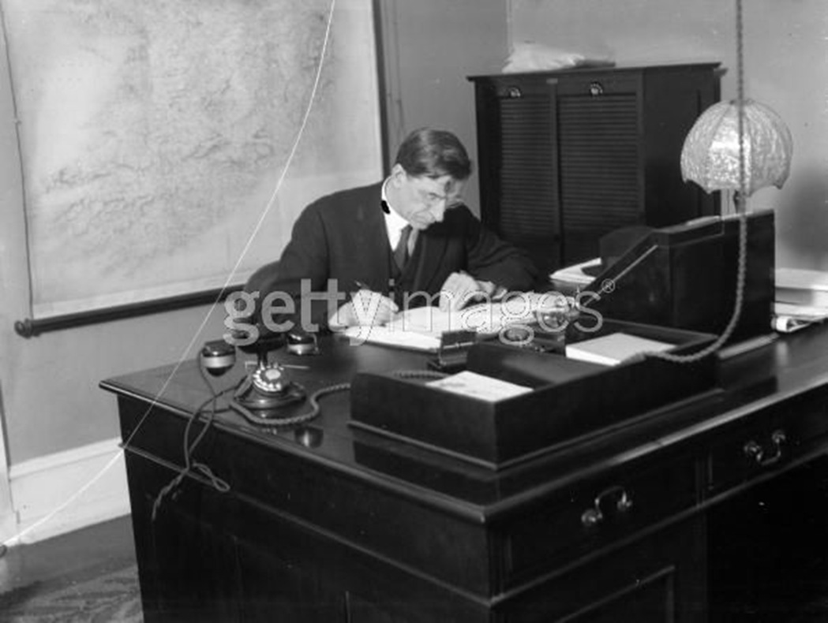
Flanna Fail in power
The New Cabinet
De Valera was now President of the Executive Council, but he also took on the role of Minister for External (foreign) Affairs

Slide 73
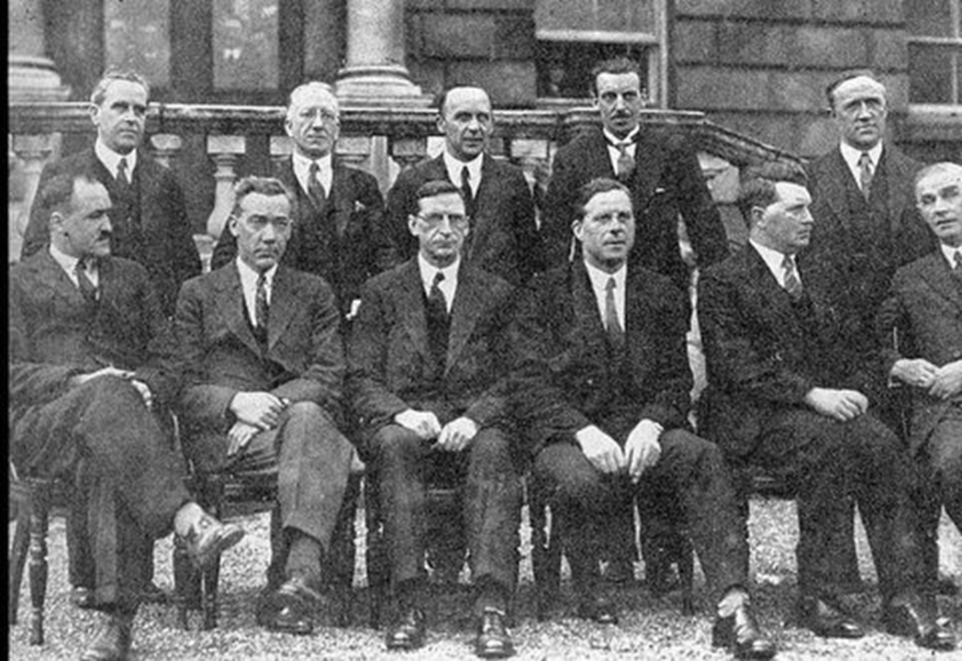
Also in the cabinet
Sean MacEntee (Finance),
He was assisted by Sean T O’Kelly as Vice President (and Local Government),
Sean Lemass (Industry and Commerce),
Frank Aiken (Defence),

Slide 74
Foreign Policy = Anglo-Irish Relations

Slide 77
The Governor-General
De Valera sought to reduce the importance of the position by ignoring him.
The King had to act on the advice of his cabinet ministers, and dismissed Mac Neill.

Slide 78
Domhnall Ó Buachalla

Slide 79
The Governor-General
Never appeared in public and functioned only to sign legislation passed in the Oireachtas.
The office was formally abolished in 1937.

Slide 80
The Privy Council and Senate
Since 1922, the judicial system had seen only minor change.
District Courts, Circuit Courts, the High Court and Supreme Court.

Slide 81
The Privy Council and Senate
Another avenue of appeal for the Irish court system existed with the British Privy Council.
De Valera felt that this undermined the Free State legal system.

Slide 82
The Privy Council and Senate
Used the Statue of Westminster 1931 as means of abolition of Privy Council to the alarm of the British Secretary for the Dominions.
The Privy Council itself ruled in favour in 1935 for Free State to do this!
Role of the Privy Council no longer mattered.

Slide 83
The Privy Council and Senate
De Valera now sought to remove a major obstacle in the way of his reforms; the Senate.
The Senate often delayed bills by 2 year halt.

Slide 84
The Privy Council and Senate
In 1934 de Valera introduced a bill to abolish the Senate.
He established a more refined Seneád under the new constitution of 1937.

Slide 85
The External Relations Act
King Edward VIII relationship with an American divorcée, Ms. Wallis Simpson caused a constitutional crisis in Britain.
Abdication on 11 December 1936.

Slide 86
Edward and Wallis Simpson

Slide 87
The External Relations Act
De Valera now introduced new legislation in the Dáil;
the Constitutional Amendment Act and
the External Relations Act.

Slide 88
The External Relations Act
De Valera’s two acts would greatly change the relationship between the two countries.
The Constitutional Amendment Act would: ‘delete from the constitution all mention of the King and of the representative of the crown whether under that title or under the title of governor-general.’

Slide 89
The External Relations Act
The External Relations Act would provide for the continued existence of diplomatic relations between the two countries.
This now cleared the way for Bunreacht na hÉireann 1937.

Slide 90
Society and Economy
The Economic War
Agricultural Policy
Industrial Policy
Social Policy

Slide 91
Anglo-Irish Agreement 1938
Under the new Constitution in 1937, Éire as it now became known, was almost a republic.
British PM, Neville Chamberlain was also eager to come to a new agreement with the Irish.
Mutual desire to end the costly economic war.

Slide 92
Neville Chamberlain

Slide 93
Anglo-Irish Agreement 1938
On 25 April 1938, three separate Anglo-Irish agreements were concluded; on finance, trade and defence.
The defence agreement saw the handing over of the so-called ‘treaty ports’ of Lough Swilly, Berehaven and Queenstown (Cobh) to the Irish.

Slide 94
Anglo-Irish Agreement 1938
The Trade Agreement- The Irish government would pay a once off payment of £10m in settlement of outstanding claims between the two countries.
Tariffs placed on each other during the economic war would now be lifted.

Slide 95
The 1937 Constitution
It was drawn up and debated from March to May and brought to the nation under a referendum in June resulting in 685,105 for and 526,945 against. - close
On 29 December 1937 the Constitution Bill came into effect with the main articles being:

Slide 96
The 1937 Constitution
The name of the Irish Free State would be changed to Eire.
Articles 2 & 3 related to Ireland as the island of Ireland and its surrounding territories, claims to both North and South.

Slide 97
The 1937 Constitution
(vi) Article 44 placed a special standing for the Catholic Church in society.
The 1937 constitution can be seen as perhaps De Valera’s long-lasting contribution to the State.

Slide 98
Ireland during the Emergency 1939-45
https://www.youtube.com/watch?time_continue=200&v=UseZIQ5UlU8 242-
Irelands stance: Neutral
Why?
1. A desire to remain neutral from international conflicts – League of nations experience
2. Lack of military strength - Self protection
3. Desire to emphasise Ireland's independence from Britain – Ultimate test
4. While partition existed Ireland would not support Britain – Fully Independent Ireland aim
Key Concepts = Neutrality & Sovereignty

Slide 99
Neutrality
Ireland declared itself Neutral on day war broke out
Emergency Powers Act – gave Ireland authority to do this – allowed Ireland to make decisions relating to its public safety
Return of Treaty ports in 1938 Anglo –Irish agreement allowed Ireland to be neutral
Britain was even considering giving Ireland unification (get rid of border) to get their assistance in War—Why?

Slide 100
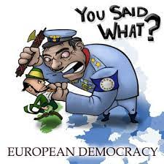
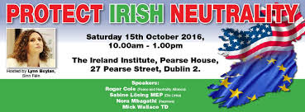
How Neutral is Neutral?

Slide 101
How Neutral is Neutral?
Press censorship & control of radio and no weather forecasts
De Velara offered condolences on the deaths of Roosevelt (US) & Hitler (Germany)
However Ireland were more “friendly” to the allied side
Information given to Britain on all “German aliens” in Ireland
Ireland allowed airspace to be used sparingly by Britain
Secret weather forecasts given to Britain

Slide 102
Threats to Neutrality
IRA – Bombing campaign against the British 1939 over the view “Britain’s difficulty is Irelands opportunity”
IRA Cooperated with Germany – German spies landed and helped/encouraged bombings at the border
DeValera responded strongly – Camp in the Curragh where 500 IRA members were held, 5 executed – IRA almost wiped out by end of WW2
http://mcsweeneyhistory.weebly.com/20th-c-ireland-ff-in-power-1932-1948

Slide 103
Impact of Neutrality
Popular policy, DeValeras speech at end of war struck a cord with people
Economically: Industry was hit due to shortage of materials - inflation high (70%) so living standards fell
Unemployment was high as was emigration to Britain
Agriculturally: Vital sector and earned money from exports to Britain but could not maximise profit due to not being fully recovered from Economic War
https://www.youtube.com/watch?v=onlGWRXkZv0

