Slide 5
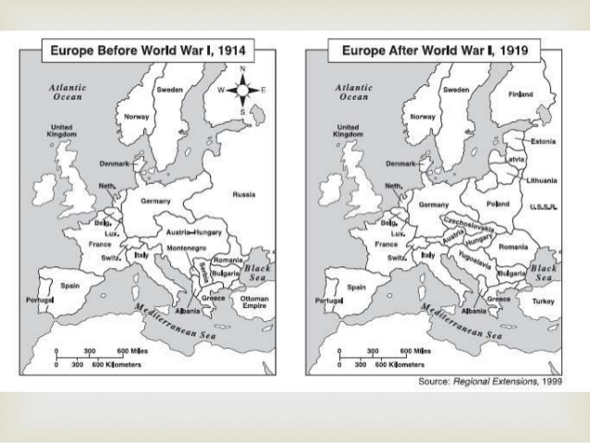

Slide 8
Past Exam Questions
1. Why was the League of Nations set up in 1919? (2012 HL)
A. It was set up after WW1 to prevent any more wars breaking out
2. Explain one of the following terms: (2009 OL) Dictator; Superpower;
A. Superpower = The two major powers after WW2 i.e. USA & Soviet Union
A. Dictator = Ruled by a single person or party i.e. Hitler. Laws can be passed without votes
3. Give two terms of the treaty of versailles in relation to Germany?
A. Germany had to take the blame for starting WW1
A. Germany had to pay compensation to its neighbours (Reparations)
A. German army restricted to 100,000 men

Slide 9
Past Exam Questions
​4. In relation to Versailles what was the war guilt clause?
A. This was where Germany had to take the full blame for starting WW1
​5. Who were the big three (leaders or countries) at the Treaty of Versailles?
A. USA, Britain, France - Woodrow Wilson, Lloyd George & George Clemenceau

Slide 10
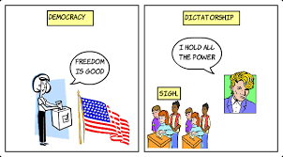
The Big Question: Democracy or Dictatorship
Democracy: The people are free to choose their own government in an election
Dictatorship: Ruled by a single person or party i.e. Hitler. Laws can be passed without votes & strict censorship is imposed

Slide 11
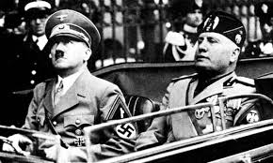
DICTATORSHIPS: Censorship/Propaganda was central to both
FASCISM: Strong government led by a dictator, believed in nationalism & private ownership of companies & land and control of press – anti-communist
COMMUNISM: The state (dictator) controls all land and power, for the good of the people, to make everybody equal (Russia under Lenin/Stalin)

Slide 13
Recap Q&A
Which treaty formally ended World War 1?
Was it fair or unfair on Germany?
Name one thing Germany had to do as a result of treaty
Name another Name one more……….anyone?
What was the League of Nations?
What was the aim of the League
Was it a success

Slide 14
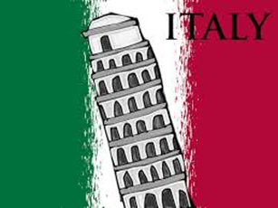
Rise of Fascism

Slide 15
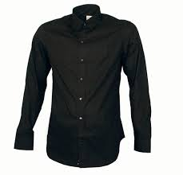
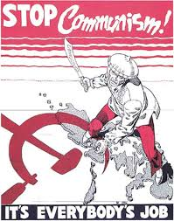
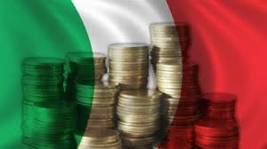
Benito Mussolini
After WW1 Mussolini founded the Blackshirts, a Fascist party in Italy
They rose to power because
Italian Economy suffered badly during WW1
Businesses feared the growth & spread of Communist in Italy & wanted a strong leader to oppose it.

Slide 16
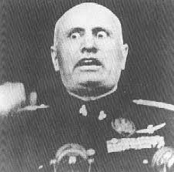
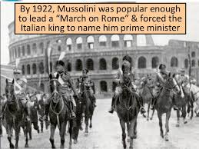
Benito Mussolini
The Fascists got stronger as they used violence against their political enemies, especially socialists
The fascists (30,000) planned a MARCH ON ROME in October 1922 – to demand a role in government
King Victor Emanuel III did not want to use violence against the fascists & did not want a bitter civil war so after negotiations Mussolini became PM

Slide 17
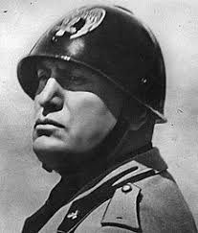
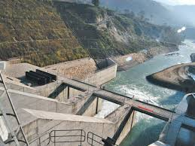
Benito Mussolini:Domestic/Political achievements - Account
Mussolini used Acerbo Law - ensured fascist majority Gov.
All opposition political parties were banned
Autarky = sufficiency – Fascism
He built a Hydro electric power station – Where did we see this before???

Slide 18
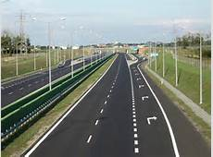
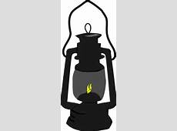
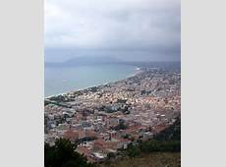
Benito Mussolini:Domestic/Political achievements - Account
Mussolini solved Italy’s economic problems by creating a corporate state
Unemployment was tackled by the building of Autostrada (motorways) = created jobs
Also Pontine Marshes (outskirts of Rome)were drained & built into agricultural land – created jobs
He made historic peace between the state & Catholic church (50 year argument) by signing the Lateran Treaty
Mussolini’s successes were not all that great but he used propaganda to over exaggerate them i.e. rewriting History books

Slide 19
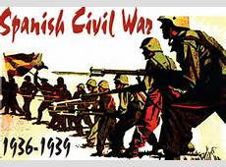
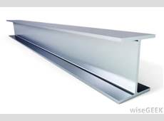
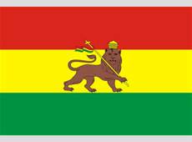
Mussolini: Foreign policy & downfall
Mussolini wanted to build an empire so in 1935 he invaded Abyssinia (Ethiopia)- TO RESTORE ITALIAN PRIDE
1936-1939 sent 50,000 troops to help Genral Franco in Spanish Civil War
1936 – Mussolini made an Alliance with Adolf Hitler (Rome-Berlin Axis), later called Pact of Steel & in 1940 Italy entered WWII on German side
Pact Biggest mistake for MussolinI as when Germany were defeated in 1945 Mussolini was captured & killed By anti-fascists known as PARTISANS

Slide 20
PEQ
Explain TWO of the following terms, in relation to Mussolini: (2015 HL)
A. March on Rome: When Mussolini and 30,000 were marching to get a role and power in Government
A. The Lateran Treaty : The treaty which Mussolini signed which ended fighting between catholic church & Government
A. The Abyssinia Campaign: Mussolinis attempt to take over Abysinia to restore Italian pride after WW1
Give two reasons why Fascism became popular in Europe in the 1920's
Italy feared Communism and wanted a strong leader to resist it
Italian economy suffered after WW1
Italy did not get what it was promised from Treaty of Versailles
Which Italian leader was known as Il Duce A. Bennito Mussolini

Slide 24
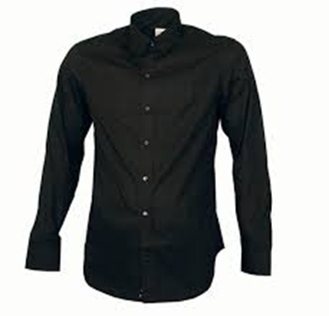
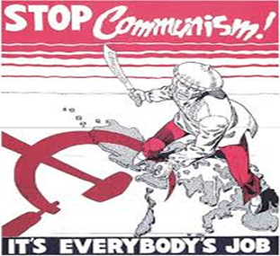
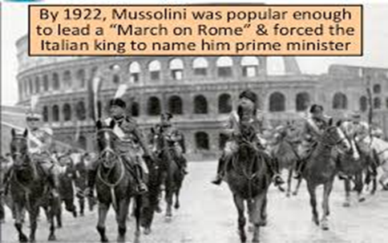
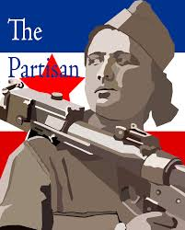
Recap Q&A – Story so far – miss a q – pink box page 283

Slide 25
HITLER AND NAZI GERMANY

Slide 26
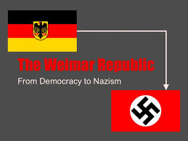
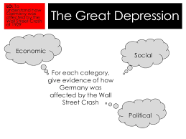
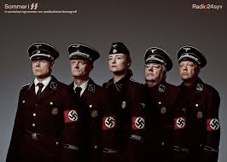
HITLER AND NAZI GERMANY: Rise of Nazism &Hitler – how/why??
Weimar Republic (democratic) was weak & many had more power in Germany before its introduction after WW1
Great Economic Depression – After wall street crash 1929 high unemployment (6million by 1932)
Treaty of Versailles: Accepted by Weimar republic – angered all German people – Hitler promised to remove it
The SA & SS (Heinrich Himmler) – two paramilitary groups who attacked opponents of Nazism and caused chaos in Germany https://www.youtube.com/watch?v=8AW9BRphH4w&index=53&list=PL4bn0pCEuAfW18Yrd8-5u9fOC3cEbge5z

Slide 27
Hitler in Power: der furher (Domestic Policy)
As Chancellor he passed the Enabling Law– could create his own laws
Hitler created a Nazi dictatorship
All political parties except Nazi party banned
Used the Gestapo (secret police) to put down opposition
Appointed Goebbels as minister for propaganda – controlled press/radio & set up Hitler Youth (boys) & League of German Maidens (Girls) for students to join - https://www.youtube.com/watch?v=betB1_uq4s8
Improved German Economy: reduced unemployment from 6Mill- 0 between 1933-39, built autobahns (motorways)
He began conscription & rearming/expanding German military

Slide 28
Recap Questions: miss one write out key terms page 302
Give one reason why Hitler & Nazi power rose to power –
Give another reason –
And another….bonus Q
Name one of the two paramilitary groups who attacked opponents of Nazi Party –
What was the Enabling Law –
Who were the secret police force who put down/got rid of opponents of Nazism? –
What was the Nazi youth League –
Who were the League of German Maidens –
List one of Hitlers Economic achievements –
List another…someone who missed a Q
https://www.youtube.com/watch?v=VP96S9vwHzI

Slide 29
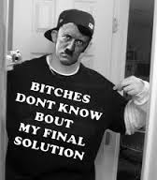
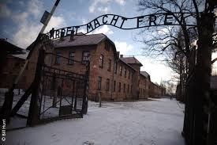
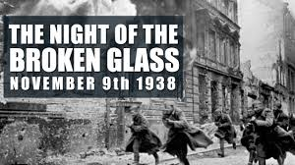
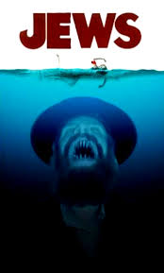
Hitler & the Jews

Slide 30
Hitler & The Jews
Hitler was anti-semetic (Anti Jewish) – first shown in hid book MEIN KAMPF
Hitler passed the Nuremberg laws (1935) - Jews can’t marry non Jews, cant get German citizenship & had to wear star of David
Night of the broken glass (Kristallnacht) – 90 Jews killed, stores & synagogues attacked & burned - 1938
Hitler’s Final Solution: Mass murder of Jews – known as holocaust – (1941)
Jews were rounded up by SS and put in Ghettos (Jewish only areas) & Concentration camps i.e. Auschwitz & Treblinka
Up to 6 million Jews killed (gas chambers/firing squads) by Nazis
https://www.youtube.com/watch?v=OD8QNF_2QqQ
https://www.warhistoryonline.com/whotube-2/auschwitz-birkenaudrone.html

Slide 31
PEQ – Rise of Hitler
Short Questions
1. In relation to Hitler explain two of the following The Enabling Act Knight of the Long Knives The Pact of steel
2. Describe how fascist leaders such as Mussolini & Hitler used propaganda to extend their power
3. Mention two ways the German Nazi party used Propaganda to gain support
4. In relation to Hitler & the Jews, what was the final solution
5. In November 1938 what happened during Kristallnacht in Germany?
6. Explain THREE of the following terms in relation to Hitlers rule in Germany Night of the Long Knives The SS Nuremburg Laws Enabling Act
7. Mention two actions taken by Hitler to help become dictator of Germany
8. Who was head of Propaganda in Nazi Germany under Hitler
9. Give two reasons why Nazis became popular in Germany in the 1920's and 30's
10. What was the Hitler Youth in Nazi Germany

Slide 32
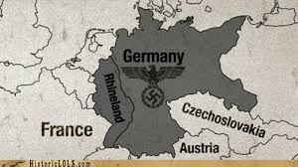
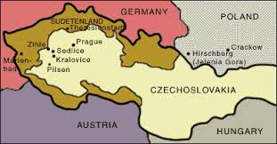
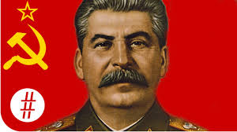
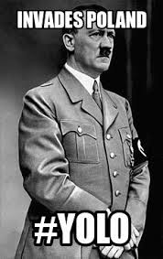
Hitler’s 5 Steps to War (WWII)

Slide 33
Hitler’s 5 Steps to War: Hitler's Foreign Policy aims 1933-39 = 1. To make Germany great again 2. Unite all German speaking people under his rule 3.Expand Lebensraum (living space) in Eastern Europe
Rhineland: Hitler broke the Treaty of Versailles & sent troops to the Rhineland – Britain & France done nothing
Anschluss (unity): Hitler believed all German speaking people should be part of a German Empire- invaded Austria march 1938- Britain & France done nothing
The Sudetenland: German speaking part of Czechoslovakia – @Munich conference – Britain/France agree Germany can take it over
Lebensraum: Rest of Czechoslovakia: Within 6 months of Munich Conference Hitler took over rest of country for “Living space” for his new super race
Poland: Stalin & Hitler had non aggression Nazi-soviet Pact & secretly agreed to divide Poland. Hitler broke this and invaded Poland September 1st 1939
https://www.youtube.com/watch?v=PCXSuaOozDE&index=82&list=PL4bn0pCEuAfW18Yrd8-5u9fOC3cEbge5z
Note:: France & British policy of appeasement towards Germany (to avoid another war & economic depression at time) clearly did not work!!!

Slide 34
Recap Questions: miss one write out key terms page 312
Give one reason why Hitler & Nazi power rose to power –
Give another reason –
Name one of the two paramilitary groups who attacked opponents of Nazi Party –
What was the Enabling Law –
Who were the secret police force who put down/got rid of opponents of Nazism?
List one of Hitlers Economic achievements –
List & explain one of hitlers 5 steps to war –
List & explain another
One more…..
Bonus q ….1 more

Slide 35
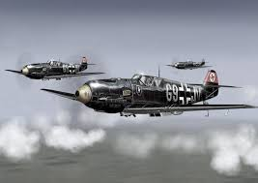
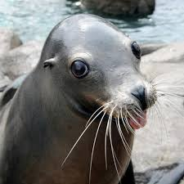
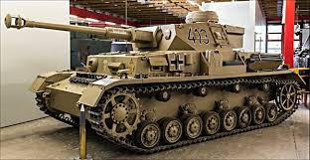
World War II: 1939-45

Slide 36
WORLD WAR II: Start & Early German Victories - grid
https://www.youtube.com/watch?v=wvDFsxjaPaE
September 1st 1939 Germany invade Poland and take over in 6 weeks using Blitzkrieg tactics – 3 steps ( Luftwaffe planes, Panzer Tanks, infantry soldiers take control of area)
Marks the official start of WWII as Britain & France declare Ware
Winter 1939 – 40 no fighting (Phoney War)
May 1940 - Next Belgium, Holland & France – Blitzkrieg tactics to cut off British & French forces at Dunkirk, & easily defeated Maginot Line (French border with Germany) and then ruled France – Vichy rule

Slide 37
Early German Victories WW2 Timeline
September 1939 – Germany invaded and occupied Poland.
April/May 1940 – Germany invaded and occupied Denmark and Norway.
10th May 1940 – Hitler launched a Blitzkrieg against Holland and Belgium. Both countries were occupied.
19th May 1940 – British troops were pushed back to the beach at Dunkirk and had to be rescued by British boats.
22nd June 1940 – France was occupied by Germany (Vichy Rule).
Early 1941 – Germany and Italy attacked and had successes in Yugoslavia, Greece and North Africa.
22nd June 1941 – Germany attacked Russia (Operation Barbarossa) and had made some gains.

Slide 38
Q&A - Miss one Key terms page 312
Give one reason why Hitler & Nazi power rose to power
Who was head of Propaganda in Nazi Germany under Hitler
Name two reasons Germany was angry about the Treaty of Versailles?
Why was the League of Nations set up and was it a success or Failure
What was the Enabling Law
List one of Hitler's Economic achievements
Give two of Hitler’s steps to war
what did Hitler & Stalin agree in the Nazi soviet pact of 1939 – Pact of Steel
Explain the following term Lebensraum
What was Kristallnacht?
What was Hitler's Final Solution & name a place
Explain the term – Anschluss
What was the Maginot Line
What was appeasement?
From your study of WWII what was Vichy France
Explain the term Phoney War
Name two countries invaded by Hitler in April 1940
What was meant by the term Blitzkrieg?

Slide 39
Battle of Britain – August 1940 A.Q. – 10/12 MARKS GRID
Following fall of France Britain stood alone V Nazi Germany
Churchill ‘We shall never surrender’.
German plan = Operation Sea Lion – an immediate invasion of Britain
Luftwaffe would need to control skies over Britain – Luftwaffe V RAF Spitfires & Hurricanes
Britain gained victory through the RAF and the use of Radar, which told them where Luftwaffe were
Operation Sealion was followed by THE BLITZ – Hitler change of tactic to Lutwaffe bombing attacks on cities i.e. London/Coventry
Decisive win for Britain: They successfully defended against the Germans

Slide 40
Miss a question –write pages 322-323
What date did Germany invade Poland to start WWII – Aidan
What date did Britain & France officially declare war on Germany – Jay
What was the Phoney war & when was it – Hope
Why in April1940 did Hitler invade Denmark & Norway – Lukasz
What was Churchill famous for when it came to motivating the British army & Public – Marc
What was Operation Sea lion – Adam
How did the RAF Defeat the Luftwaffe IN Battle of Britain- Ethan
What was the Blitz – Clodagh
What was the name of the line the Germans defeated in France (France border with Germany)
What was Vichy Rule - Anyone

Slide 41
WWII: German Soldier in Operation Barbarossa Q&A:
How many German Soldiers were involved in Operation Barbarossa –
What was Operation Barbarossa –
What famous military Tactics did the German military use in Operation Barbarossa –
What were the 3 stages of Blitzkrieg –
What was the name of the pact that Hitler decided to break when he invaded Russia/Soviet Union? -
Give me one reason why Hitler invaded – Kayleigh
Another reason –
What was the name of the policy that the Soviets used to defend against the Germans –
What happened at battle of Stalingrad – ?

Slide 42
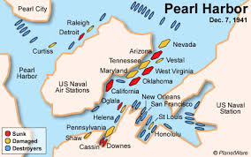
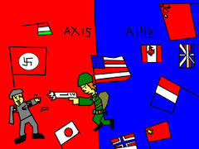
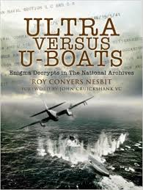
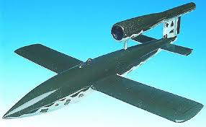
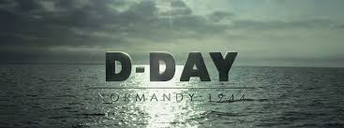
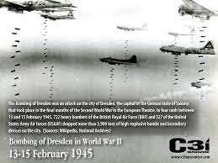

Slide 43
US Involvement & War on land Air & Sea
US joined the war when Japan (helping Nazi Germany) bombed Pearl Harbour (Hawaii) in December 1941 – destroying US Battleships & planes https://www.youtube.com/watch?v=bxIsVYdB0lA
War became Allies (US , Britain, Russia) vs Axis Powers (Germany, Italy & Japan)
Britain & US won the war at sea – Battle of Atlantic – attacking & defeating German U Boats bringing supplies – they won because of advanced shipbuilding & using ULTRA – Cracking German codes - the enigma https://www.youtube.com/watch?v=Fg85ggZSHMw
Air war: Britain & US bombed Germany by day & night – cities such as Hamburg & Dresden (30,000 killed in 1 raid)
Germany responded by using V1 Flying Bombs & V2 Rockets
Germany had been driven from Russia & were on the defensive – next vital step by allies – Operation Overlord - D-Day JUNE 6 1944

Slide 44
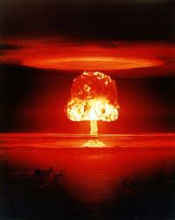
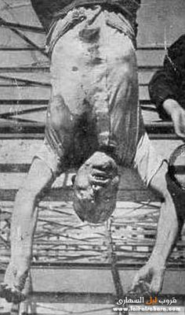
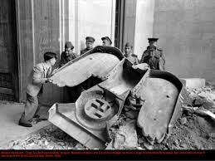
Allies push to victory + fall of Berlin
https://www.youtube.com/watch?v=OPcRfzRtM9o

Slide 45
Allies push to victory + fall of Berlin
D-Day victory for Allies at Normandy – took just over 2 months for allies to LIBERATE (Free) France from German control – August 1944
Allies then into Italy - overthrew Mussolini and his pro-Nazi Government in 1945 – Mussolini then killed by Italian Partisans (anti-fascists)
Big three allies meet continuously during war = Britain, USA & USSR (Russia) i.e. 1945 Yalta Conference – decisions (Soviets enter war against JAPAN & Germany would be demilitarised after war
As the allies pushed onto Berlin – in a three point attack – (East, North, South) 45000 German troops defended Berlin
Battle of Berlin – Late April- early may 1945 – one of bloodiest battles – Hitler hid in a bunker and committed suicide as Germans surrendered to allies
By May 1945 Japan military was in ruins & US President Harry Truman decided to drop ATOMIC BOMBS (August 1945) on Hiroshima & Nagasaki – terrible impact of bombs made Japan surrender – 80000 killed immediately

Slide 46
Results of WWII
55 MILLION DIED – SOLDIERS & CIVILIANS
Nazi war criminals tried & sentenced – NUREMBURG TRIALS
Two new “SUPERPOWERS” were found -USA & USSR
Germany was divided into two – East Germany controlled by USSR & West Germany- Britain, France & USA
Europe wanted PEACE & UNITY– eventually ended up with modern day EU
https://www.youtube.com/watch?v=2ez5G1khwTo&ebc=ANyPxKoKVv4ncYZYalGUP28vcVuknpcTu9S-o0W9EanPIMCsR1-hfqHS8FZDpHbWgo5T-zhnmH3OJWGbHMOk-8u6H_a9hDBz4w

Slide 47
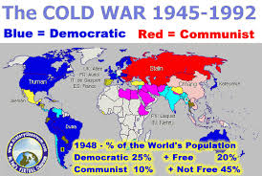
COLD WAR

Slide 48
COLD WAR: CAUSES
Disagreements during WW2 . The US slow to open ‘second front’. 27 m Russians died & Atomic bomb not shared with USSR.
Political differences: USA = Capitalist economy (Democracy) & Soviet Union = state controlled economy (communism)
Marshall Plan: US offered to help Europe’s Economic recovery after war – Stalin stopped European countries getting help from Marshall Plan
Truman Doctrine:– US Policy to stop spread of Communism
https://www.youtube.com/watch?v=wVqziNV7dGY&index=15&list=PL4bn0pCEuAfW18Yrd8-5u9fOC3cEbge5z

Slide 49
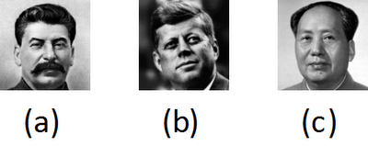
Three Case studies of cold war
Typical exam questions are 10-12 marks on these topics, short questions on key terms as well i.e. What was Truman Doctrine
Long q = Name one of the leaders shown above (a), (b) or (c) and write an account of a major crisis in the Cold War, 1945-63, in which that leader was involved. (14) or Write an account of a named major crisis in the Cold War between the USA and the USSR during the period, 1945-63. (12)
Topic 1: Berlin Blockade
Topic 2: Cuban missile crisis
Topic 3: Korean War

Slide 50
The Berlin Blockade 1948-49 – Grid 1 special topic
After WWII the allies divided Germany into 4 zones – Soviets (Russia), American, British & French
US believed a better German economy would prevent another rise of Nazism & wanted to use Marshal aid, Soviet’s disagreed
A new currency was set up “Deutschmark” – Soviets didn’t agree and so cut off all road, rail & canal transport in & out of Wast Berlin (Communist area) = BERLIN BLOCKADE (June 28 1948)
Other three – organised “OPERATION VITALS” – to fly supplies into Berlin – cargo planes flew in food, coal, petrol & Medical supplies
At highest point planes flying in every 90 seconds!! 26.5 planes in class

Slide 51
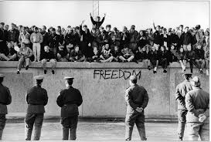
The Berlin Blockade 1948-49
Stalin also cut electricity into West Berlin – work suffered & 120,000 people lost jobs
Stalin did not want another war and once he saw Truman would not back down he ended the blockade May 12 1949 (less than one year)
RESULTs:
1. Tensions grew between soviets & US and early cold war victory for US.
2. Berlin wall built 1961
3. Berlin was now divided in two – East & West and would remain divided until 1990
https://www.youtube.com/watch?v=Y5SCwBLvEqw

Slide 52
Q & A Berlin Blockade
How many zones was Germany divided into after WWII- Jack
What was Marshall Aid - Fionn
What was the name of the new German currency developed – Kaithlinn
How did the Soviets respond to this – Liam
What was Operation Vitals – Amy
What did Stalin do to stop the air lifts - Ciara
Give one result – Adam C.
Give another - Lia
Third result- Somebody who missed a question

Slide 53
Korean War 1950-53 Grid 2 special topic
After WW2 Korea divided into Communist North (Soviet supported) & Democratic South (US Supported)
Divided by 38th parallel
1950 Communist north invade the south
US President Truman entered the war – policy of Containing communism – N.B. Containment policy
Communist government in China entered war to support North Korea – Mao Tse-Tsung
US Led by General Douglas McArthur - fired by Truman for wanting to attack China
War dragged on until 1953 – peace agreed and border stayed on 38th parallel

Slide 54
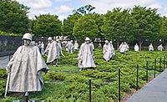
Korea war results
More than 4 million died mainly civilians – widespread destruction
Cold War had spread to Asia https://www.youtube.com/watch?v=t44SbOyjEUM
Both superpowers took part in an arms race – Developed H Bombs
US got a new ally in Japan – who provided materials for the war effort
Korea remains divided to this day

Slide 55
Korean War Q&A
Where/How was Korea divided –
Which side did Soviets support and which did US support
How did the War start in 1950?
What was President Truman's policy called to deal with threat of Communism
What other communist country joined the war to support orth Korea
Why was US General Douglas McArthur fired by Truman
Give one result of Korean war
Give another
Third result

Slide 56
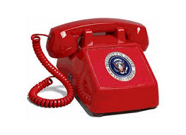
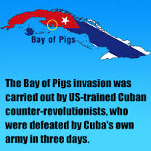
Case 3: The Cuban Missile Crisis

Slide 57
Case 3: The Cuban Missile Crisis Grid 3 special topic
Fidel Castro overthrew General Batista & made Cuba a communist state in 1959
Cuba got assistance from Soviet leader Khruschev
John F Kennedy wanted Castro gone and set up Bay of Pigs invasion to overthrow Castro –MAJOR FAILURE
U2 Spy plane spotted missile BASES being set up in Cuba – October 1962 – Khruschev said it was for Cuban protection from US
Kennedy decided to set up a naval blockade around Cuba – Soviet vessels could not get to Cuba with missiles
World was on the verge of NUCLEAR WAR
Khrushchev agreed to take down missile bases if US promised not to invade Cuba again

Slide 58
Case 3: The Cuban Missile Crisis
Results:
Both Khruschev & Kennnedy were shocked at how close they came to Nuclear war – decided to set up a “direct Hotline” to contact each other in any future crisis
Both sides agreed to sign “Nuclear Weapon Test Ban Treaty”
The USA also dismantled missiles it had strategically placed in Turkey

Slide 59
Q&A Cuban missile Crisis
Who was the Cuban leader who made Cuba communist with help from Soviet union (Khruschev)
What was the Bay of Pigs disaster
How did US find out about Soviet missiles in Cuba?
How did Kennedy respond to this?
What happened as a result of this Naval blockade?
What agreement was made between US and Soviets ?
Give one result of Cuban missile crisis
Give another
Third?

