Slide 1
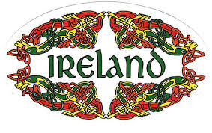
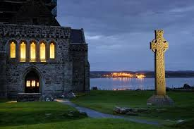
TOPIC: Celtic Ireland

Slide 2
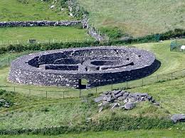
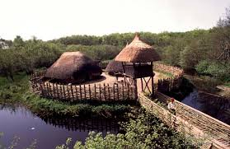
Celts – How do we know ?
Celtic myths and legends
Descriptions of Celtic tribes by Roman writers
Celtic remains – ringforts, crannogs

Slide 3
Celtic Ireland
Arrived 500BC
Warlike People (wore war paint)
Became the dominant culture – settlers
Ireland was divided into Tuath(Kingdoms), with its own Ri (King)
Iron instead of bronze – easier to find
Celtic Ireland = Iron Age

Slide 4
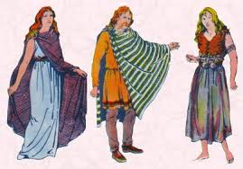
Celtic Man and Woman

Slide 5
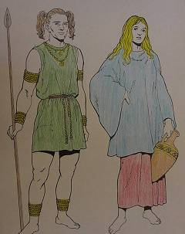

Slide 6
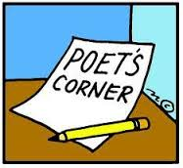
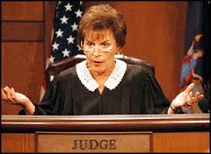
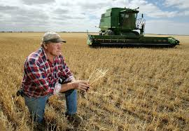
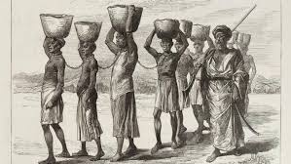
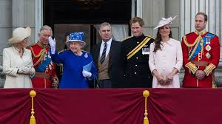
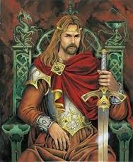
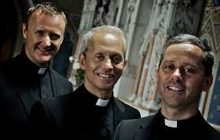
Celts Social Structure
Ri = King
Deirbhfine = Royal Family
Nobles
Aos Dana = Brehons (Judges), Druids (Priests) Fili (Poets) Craftsmen
Farmers
Slaves

Slide 7
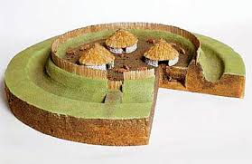
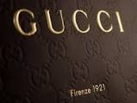
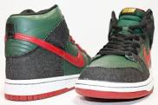
HOUSING
Your Home - Hill-forts, Raths (Ringforts) or Crannogs
Raths very common - surrounded by earthen ditch and fence
Wanted to feel safe and protected
Also wanted to keep their cattle herds safe
Your Clothing: all made locally…….
No designer brands such as NIKE & GUCCI

Slide 8
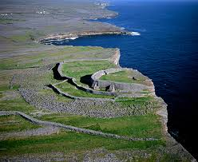
What is this?

Slide 9
what is it??

Slide 10
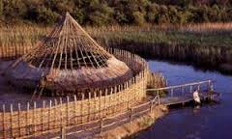
What is this?

Slide 11
CELTIC FESTIVALS
Samhain – First November – In honour of the god Daghda.
Imbolc – First February – In honour of the goddess Brigit.
Bealtaine – First May – In honour of the god Bel.
Lughanasa – First August – In honour of the god Lugh.

Slide 12
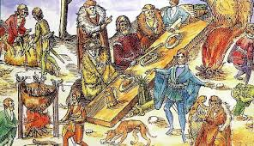
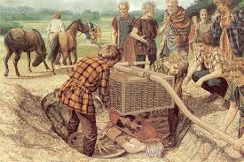
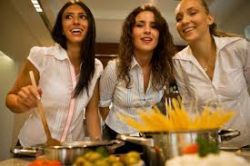
Food
10/11/15
They farmed using Cattle and Sheep for meat (fulacht fiadh)
They grew Barley (for ale), Oats (Porridge) & Wheat (flour/bread)
They also hunted wild boar and sometimes did “cattle raids” against other tribes
Cooking done by women
They held feasts to celebrate victory in battle with a hero’s portion being the best meat going to the most heroic warrior

Slide 13
Pastimes/Hobbies

Slide 14
(Person in History20 marks)A person living in an ancient civilisation in Ireland. (Celtic Ireland)
Introduce yourself and your people.
Talk about houses and settlements.
Describe Celtic society.
Talk about the food you eat, and describe feasts.
Describe the tools and weapons you use.
Describe Celtic art.
Explain the burial customs and talk about Ogham stones.

Slide 15
(Person in History20 marks)A person living in an ancient civilisation in Ireland. (Celtic Ireland)
The year is 300 BC, My name is……and I am a large Farmer in the time of the Iron Age, and so me and my people are Celts
My house is a Rath , also known as a Ringfort and its walls are made of wattle and Daub for Insulation and the roof is Thatched.
It is built on a circular ditch and I have a wooden fence for protection to stop people stealing my cattle. My friend lives in a Crannog and this is built over water and is another type of house
The Ri is the leader of my Tuath (150 in Ireland). The Deirbhfine (royal family) come below the Ri and his successor (Tanaiste) will be chosen from here.
Beneath them is the Nobles and then the Aos Dana which consists of Brehons (judges), druids (priests) and craftspeople
Below these people are the farm Labourers and the slaves
Women also play an important role in our society as they do important jobs like cooking, making clothes & bringing up the children
My diet is very mixed as sometimes I hunt animals and cook them on a Fulacht Fiadh, I also sometimes gather berries for food. However I spend a lot of time on my farm producing my own food by growing Barley (for ale), Oats (Porridge) & Wheat (flour/bread) and sometimes do a “cattle raids” on other tribes

Slide 16
My favourite food time is when we hold a feast to celebrate my Tuath’s warriors winning in battle, the best warrior gets the Hero’s portion, the best piece of meat
Cratspeople from the Aos Dana make all the tools and weapons for the warriors out of Iron. They use spearheads, axes and Swords made of Iron which is very strong and easy to find
We are very artistic people and our art is called La Tene which includes spirals and curved lines (Turoe stone Co. Galway)
I am quite sad today as I am coming from Cremating my dead uncle, We put his ashes in a cist grave and we marked it with an Ogham Stone which is a standing stone covered in Ogham Writing, which is our alphabet.
I put his favourite thing , a gold broach with his ashes
At least tomorrow I have something to look forward to as tomorrow is the Lughnasa Festival which marks the time to lift the Harvest from our Farms (August 1st) and I think it has been a good year.
I better go and dye my hair blonde so that I look good for the festival and I will wear my multicouloured Bracae (wollen trousers) and my new soft leather boots.

Slide 17
Past exam Q’S
Write an account of two of the following aspects of life in Celtic Ireland. (10 marks X2)
(a) Housing
(b) Food and clothing
(c) Work, arts and crafts
SHORT QUESTIONS 1. In Celtic times who were the Aos Dána? (2012 HL) 2. Name two important Celtic festivals. (2012 HL) 3. Name two types of dwelling places from Celtic Ireland. (2009 HL) 4. Why were cattle important to the Celts? (2007 HL)
PIH (20 marks): A person living in an ancient civilisation in Ireland.

Slide 18
Ancient Ireland: what do I need to know
How we know about the Celts (evidence).
The use of iron (Smelting- what was it?)
Celtic settlements (crannógs, hill-forts, ring-forts, promontory forts)
Celtic Society. (structure & roles)
Family life, food, work.
Burial customs and Ogham stones.
PERSON IN HISTORY: A PERSON LIVING IN ANCIENT IRELAND (20 MARKS)
Accounts: 10-12 marks (housing, tools/weapons, Celtic society, food/farming)

Slide 19
QUESTIONS…….

